Slide 1


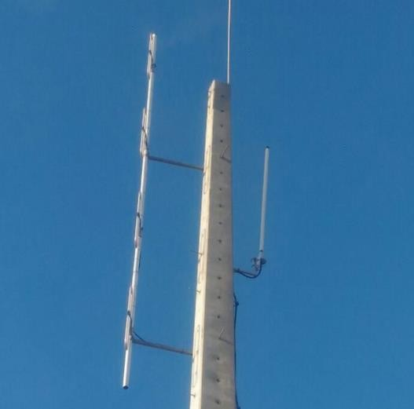
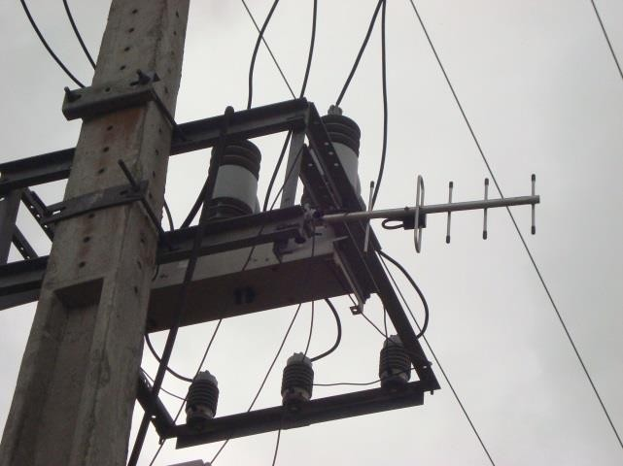
Application of Base Transceiver Station with Smart Antennas in the Power Distribution Sector

Slide 2
Summary
Context
Mathematical Model
Numerical Simulations and Results
Conclusions
References

Slide 3
Context
Distribution Automation system has grown significantly with the investments of the last 5 years.
Smart grids are key to improving the quality of energy supply.
Communication using Radio Frequency is more reliable than the use of 3G and cheaper than the use of fiber optics.
In this context, it´s important to have more efficient Base Transceiver Stations (BTSs) that can cover the communication of a larger area.

Slide 4
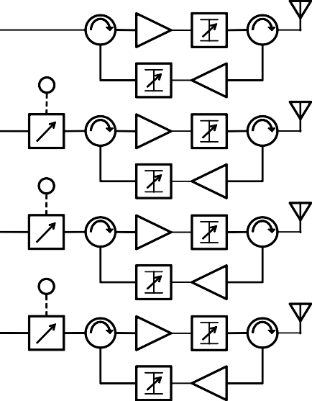
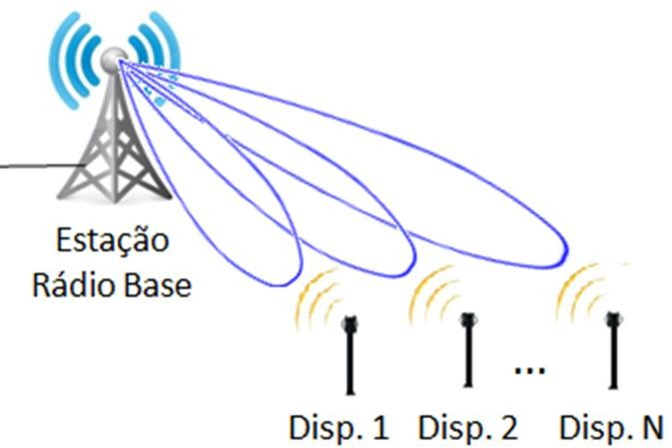
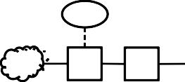
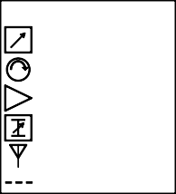
Context
System Architecture
A
θ
B
θ
C
θ
Divisor de Potência (1:4)
A, B, C
COI CAT
Rádio UHF
Legenda
_{θ} Defasador controlado
Circulador Amplificador
Atenuador ajustável
Antena
Controle digital
Input: Devices and BTS Geographic Coordinates
Output: Maximum gain in devices direction

Slide 5
Mathematical Model
For Antenna Array, there are 5 control mechanisms.
  Geometric configuration of the array (Linear, Circular, Planar);
  Relative separation between elements;
  Relative diagram of individual elements;
  Amplitude of excitation of each element;
  Electrical excitation phase of each element;
The first 3 mechanisms are related to geometric factors, while the latter with electrical factors.
The main objective is to initially define the geometric factors and perform intelligent control by changing the electrical factors.

Slide 6
Mathematical Model
To introduce the mathematical concept, we will develop the equations for a collinear array with N elements with the same excitation amplitude and a gradual increase in the electric phase β of excitation.
Before beginning
the mathematical development, it is
important to define the radiation pattern in terms of the antenna element type and the geometric configuration of the array.
Total Diagram = Diagram of an Antenna Element x Array Factor Diagram.
NOTE: In a perfect system (isotropic source) the Total Diagram = Array Factor Diagram.

Slide 7
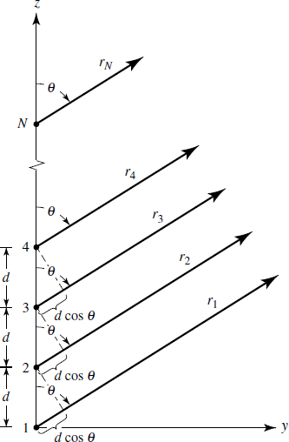
Mathematical Model
_{𝐴𝐹 = 1 + 𝑒}+𝑗(𝑘𝑑 cos 𝜃+𝛽) _{+ 𝑒}+𝑗2(𝑘𝑑 cos 𝜃+𝛽)_{+ ⋯ + 𝑒}+𝑗(𝑁−1)(𝑘𝑑 cos 𝜃+𝛽)
𝑁
_{𝐴𝐹 = ෍ 𝑒}+𝑗(𝑛−1)𝜓
𝑛=1
𝜓 = 𝑘𝑑 cos 𝜃 + 𝛽
Multiplying AF by 𝑒^{+𝑗𝜓} and subtracting AF of this product, we can arrive in the expression for the Normalized Array Factor:
1
𝑁
sin ^{𝑁} 𝜓
sin ^{𝑁} 𝜓
2 sin ₂ 𝜓
2
𝑁
𝐴𝐹 _{𝑛} =
1
𝑜𝑟
𝐴𝐹 _{𝑛} ≈
2
𝜓
The maximum value of the function AF occurs in 𝜓=0.
𝛽 = −𝑘𝑑 𝑐𝑜𝑠 𝜃₀

Slide 8
Mathematical Model
Correlation between
geographic coordinates
and the
mathematical model of antenna array.
Input parameters of the controller:
  Geographic coordinates of the Base Station, where the intelligent
antenna array system will be.
  Geographic coordinates of the remote devices where we must direct the maximum array power.
With the information of the location of the BTS and the devices, the controller converts the geographic coordinates to polar coordinates identifying the angle θ₀ where the device intended to direct the maximum power of the BTS is located.

Slide 9
Mathematical Model
Considering an
element in the geographical position
(lat,
lon), the
conversion to the system (ϴ, φ) is given by:
𝑙𝑜𝑛
𝜋 ∙ ₁₈₀ ,
𝑖𝑓 𝑙𝑜𝑛 > 0;
𝜋 𝜋𝑙𝑎𝑡
𝜃 = ₂ − ₁₈₀ ; 𝑎𝑛𝑑 𝜑 =
𝑙𝑜𝑛
2𝜋 + 𝜋 ∙ ₁₈₀ , 𝑜𝑡ℎ𝑒𝑟𝑤𝑖𝑠𝑒.
Considering the BTS coordinates are (ϴ_{BTS}, φ_{BTS}) and that the radius R of the earth remains approximately constant between small distances on its surface, the repositioning of the other devices (ϴ_{dev}, φ_{dev}) in the system (x, y, z) so that the BTS is at the position equivalent to the geographical point (lat = 0, long = 0) is given by:
𝑥
𝑦
𝑧
𝑅𝑐𝑜𝑠𝜑_{𝑑𝑒𝑣} 𝑠𝑖𝑛𝜃_{𝑑𝑒𝑣}
𝑅𝑠𝑖𝑛𝜑_{𝑑𝑒𝑣} 𝑠𝑖𝑛𝜃_{𝑑𝑒𝑣}
𝑅𝑐𝑜𝑠𝜃_{𝑑𝑒𝑣}
si n( 𝜃_{𝐵𝑇𝑆})𝑐𝑜𝑠(𝜑_{𝐵𝑇𝑆})
−𝑠𝑖𝑛(𝜑_{𝐵𝑇𝑆})
−co s( 𝜃_{𝐵𝑇𝑆})𝑐𝑜𝑠(𝜑_{𝐵𝑇𝑆})
si n( 𝜃_{𝐵𝑇𝑆})𝑠𝑖𝑛(𝜑_{𝐵𝑇𝑆})
𝑐𝑜𝑠(𝜑_{𝐵𝑇𝑆})
−co s( 𝜃_{𝐵𝑇𝑆})𝑠𝑖𝑛(𝜑_{𝐵𝑇𝑆})
co s( 𝜃_{𝐵𝑇𝑆}) 0
si n( 𝜃_{𝐵𝑇𝑆})
= 𝐴 ∙
𝐴 =

Slide 10
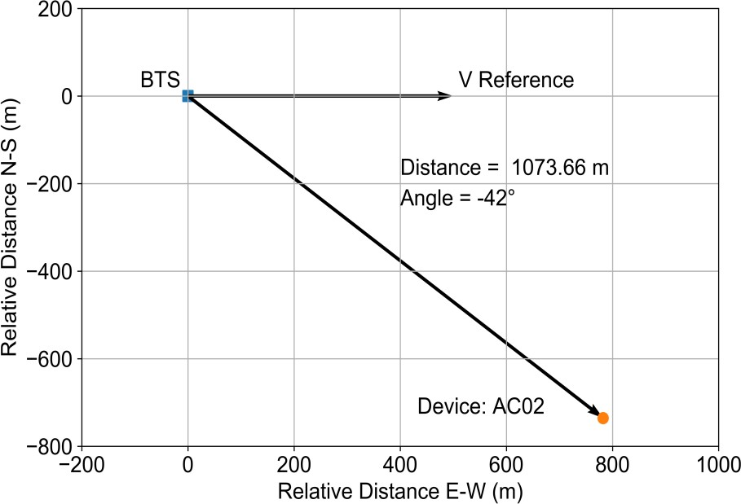
Mathematical Model
Finally, considering
the vector V_{r} as the zero-reference
direction of the antenna array, the angle δ between V_{r} and the
device positioned at the point P_{dev} = (x, y, z) is given by:
^{𝑉}𝑟 ^{∙ 𝑃}𝑑𝑒𝑣
𝛿 = cos⁻¹
𝑉_{𝑟}
^{𝑃}𝑑𝑒𝑣

Slide 11
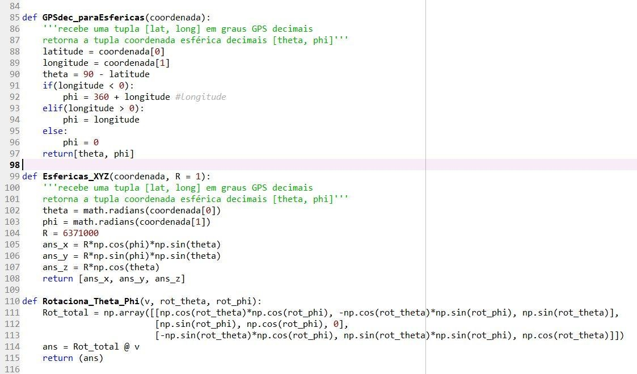
Numerical Simulations and Results
Coordinate Conversion Algorithm

Slide 12
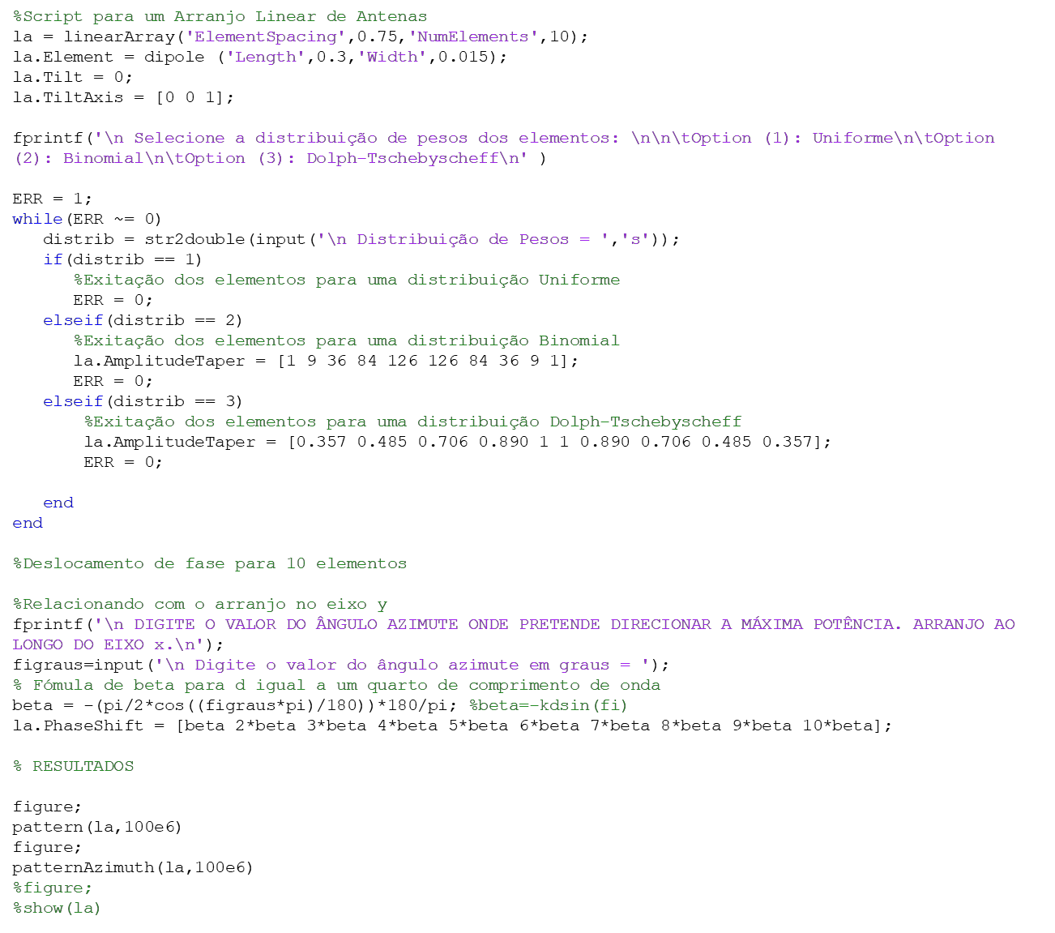
Numerical Simulations and Results
Antenna Array Algorithm with dipoles

Slide 13
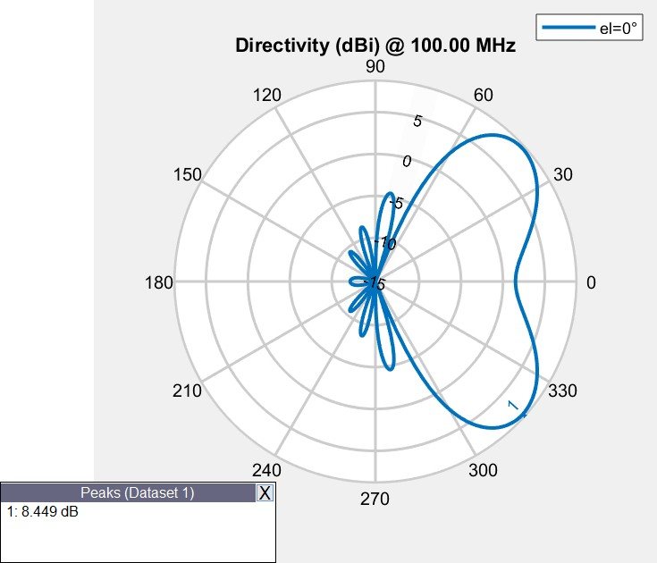
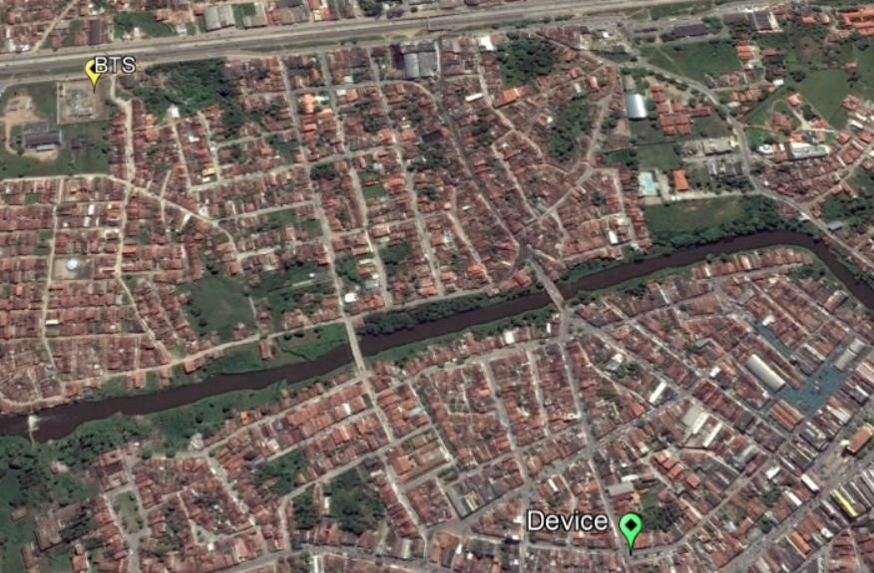







Numerical Simulations and Results
Simulation for one real devices and BTS
BTS (8°11'51.4"S, 35°34'39.7"W)
Device (8°12'51.7"S, 35°33'30.6"W)
Location: Gravatá
Result using mathematical models and algorithms
Vreference
Distance = 1,071.02 m
Fig. 10. Satellite view of the BTS and device location (by Google Earth).
θ₀ = -42°
www3.ufpe.br/laboratoriomicroondas

Slide 14
Numerical Simulations and Results

Slide 15
Conclusions
It is possible to control the maximum radiation in function of devices and BTS Geographic Coordinates.
The algorithm
for CAT worked integrating geographic
coordinate conversion and the antenna array mathematical model.
The expected results were obtained.

Slide 16
References
R. J. Mailloux, Phase Array Antenna Handbook, 2nd ed. Norwood, MA,
USA: Artech House, 2005.
L. C. Godara, “Applications of antenna arrays to mobile communications Part I. Performance improvement, feasibility, and system considerations,” Proc. IEEE, vol. 85, no. 7, pp. 1031–1060, Jul. 1997.
Y. Harkouss, H. Shraim, and H. Bazzi, "Direction of arrival estimation for smart antenna in multipath environment using convolutional neural network," Int. J. RF Microw. Comput. ‐Aided Eng. vol. 28, no. 6, e21282, Aug. 2018.
R. G. Ayestaron, "Fast near-field multifocusing of antenna arrays including element coupling using neural networks", IEEE Antennas Wireless Propag. Lett., vol. 17, no. 7, pp. 1233-1237, Jul. 2018.
BALANIS, C. A., 1938, Antenna theory: Analysis and design, Nova York.W.-
K. Chen, Linear Networks and Systems. Belmont, CA, USA: Wadsworth, 1993, pp. 123–135.

