Slide 1
Minicurso 3:
Materiais Bidimensionais
Prof. Lídia C. Gomes

Slide 2
Dia 1 (29/01)
Dia 2 (30/01)
Dia 3 (31/01)
The origin of dimensionality: an analysis of orbital hybridization in graphene.
Synthesis methods.
Some experimental achievements.
Some help from computers: ML discovery and development of new 2D materials.
General introduction. What are 2D materials?
A tiny bit of history.
Some interesting properties.

Slide 3
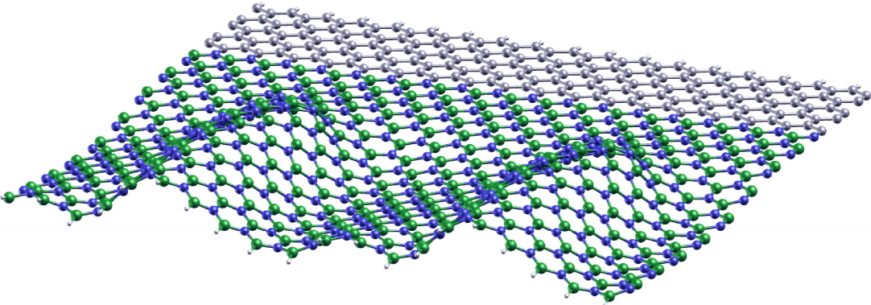
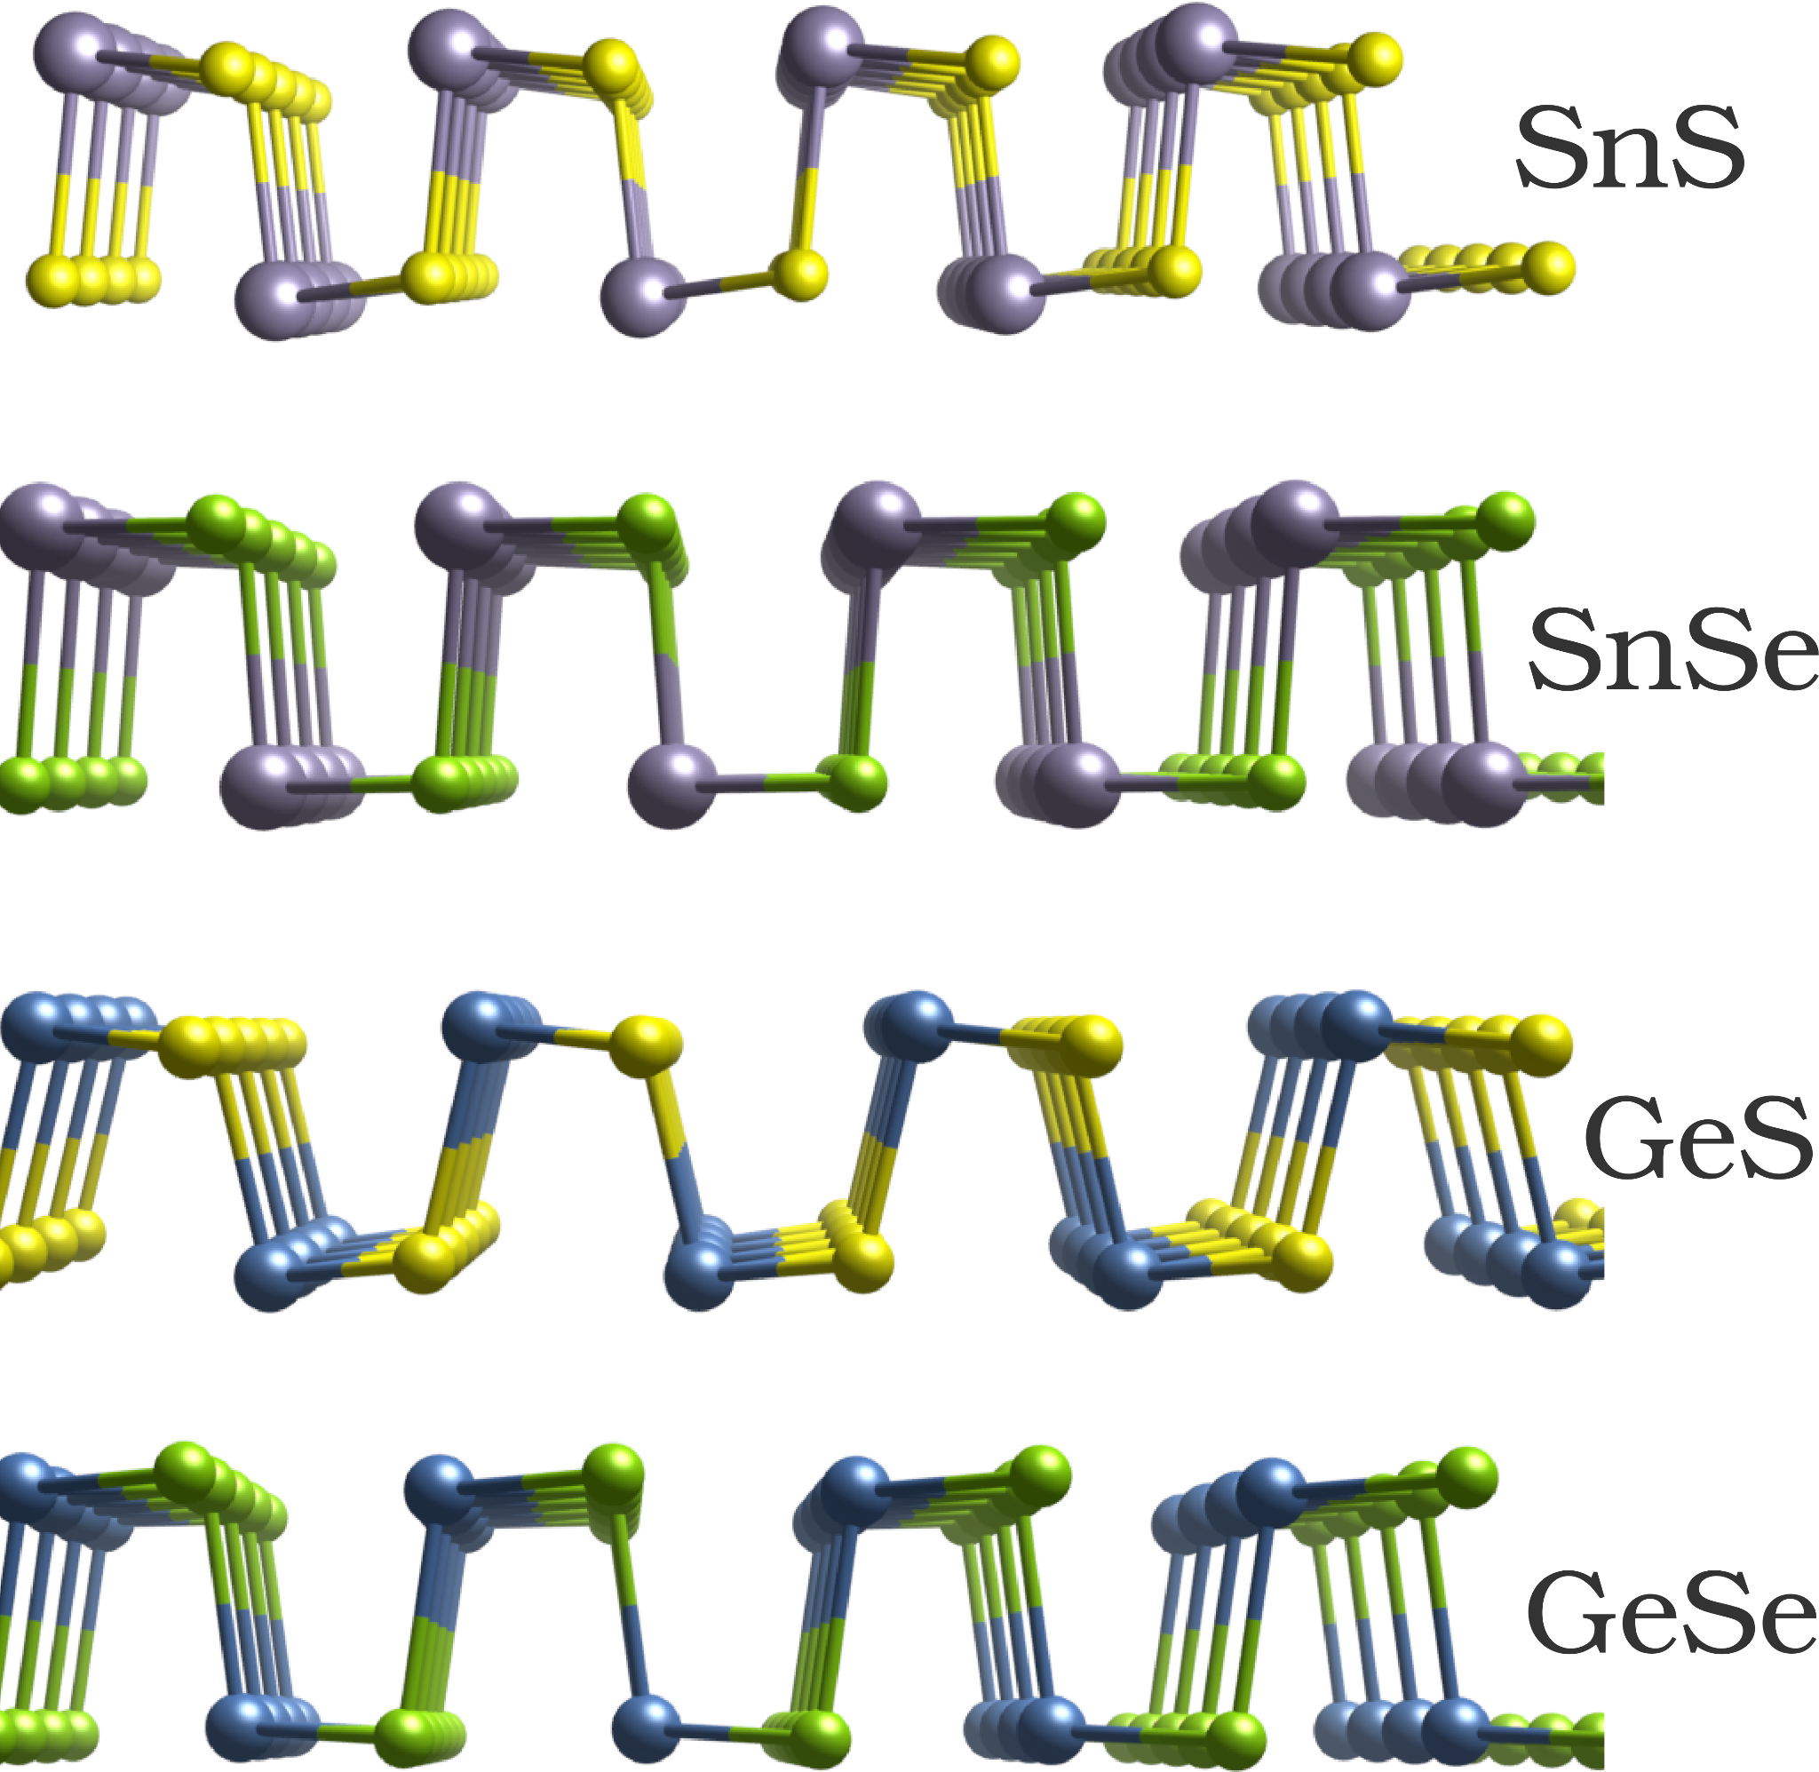
2004-2007
Licenciatura em Física - PUC MG
2008-2010
Mestrado em Física - UFMG
2010-2014
Doutorado em Física - UFMG
2014-2017
Pós-Doutorado - CA2DM, NUS
2017-2019
Pós-Doutorado - NCSA, UIUC
2020-2021
Pós-Doutorado - UIUC + IFT, UNESP
2022
Profa Adjunta - UFPE

Slide 4
Materiais bidimensionais
atomicamente finos
Cristais com um ou poucos átomos de espessura
O que são?
Interações eletrônicas no plano são muito mais fortes do que aquelas na direção perpendicular ao plano.
10⁵ µm
~ 3-4 Å

Slide 5
Materiais bidimensionais
atomicamente finos
Cristais com um ou poucos átomos de espessura
O que são?
Interações eletrônicas no plano são muito mais fortes do que aquelas na direção perpendicular ao plano.
10⁵ µm
~ 3-4 Å
Notes:
Here, we refer to “large-area” as lateral dimensions larger than 100 µm and “ultra-thin” with thicknesses of smaller than 10 nm.

Slide 6
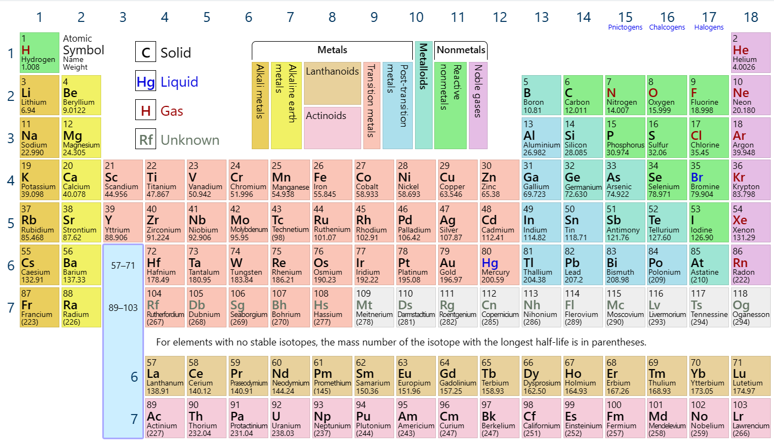

Slide 7
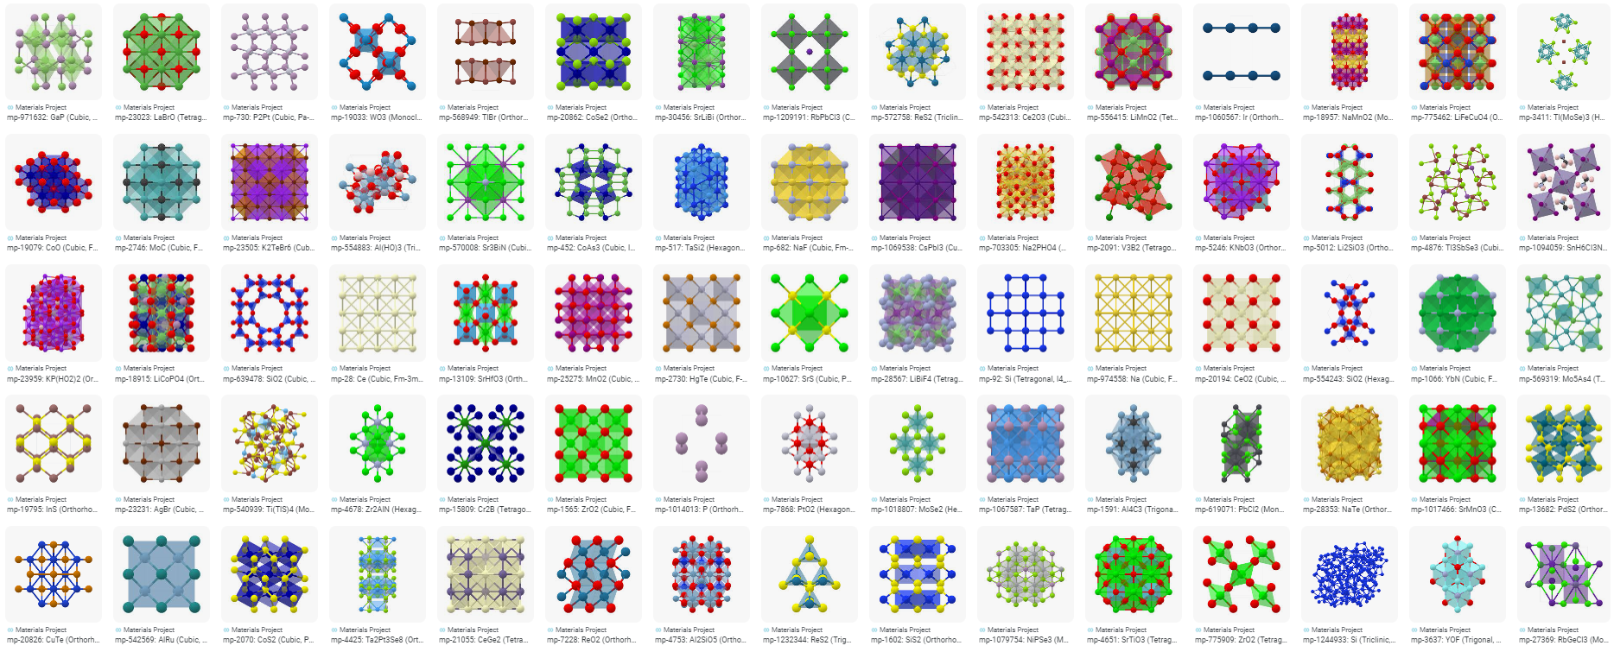
Materials Project Website

Slide 8
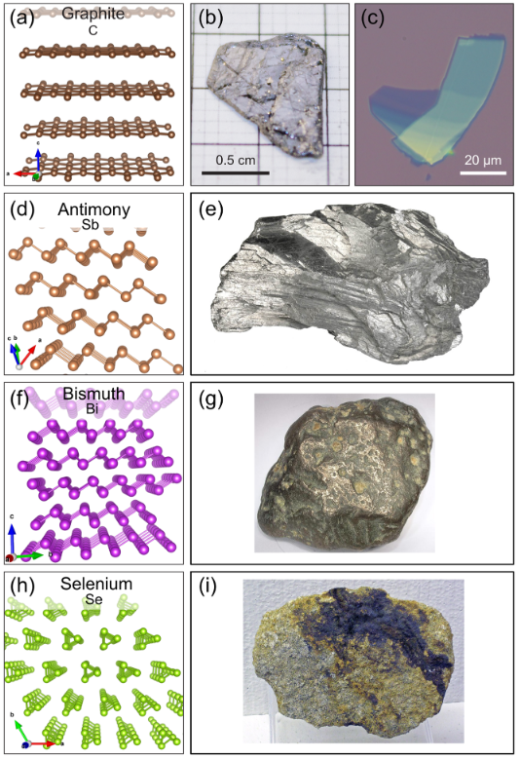
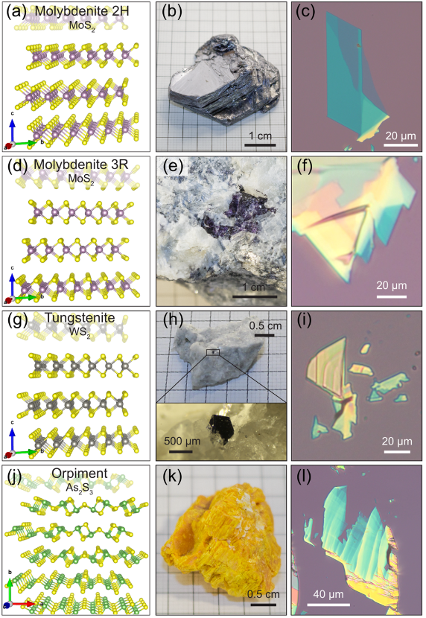
R. Frisenda, Npj 2D Mat. Appl., 38, 2020

Slide 9
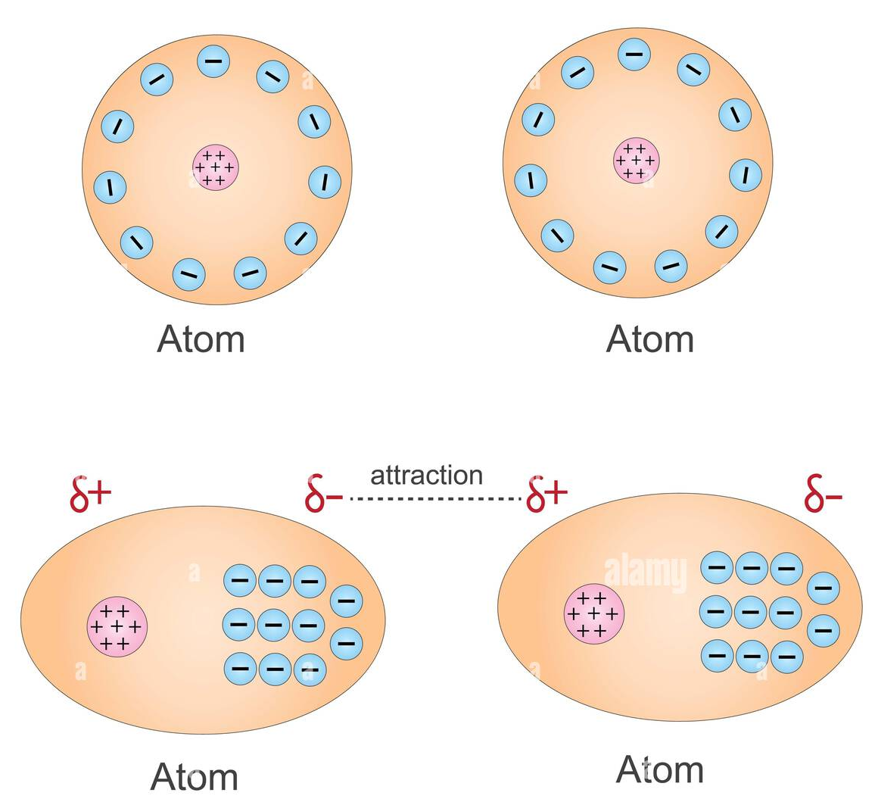
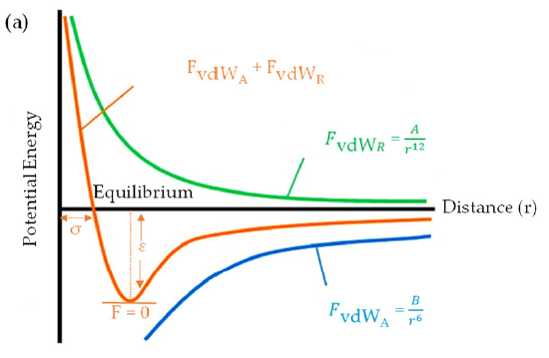
Van der Waals interactions
δ+
δ-
https://www.alamy.com/
A. Brakat and H. Zhu, Nanomaterials, 13, 2399, 2023.

Slide 10
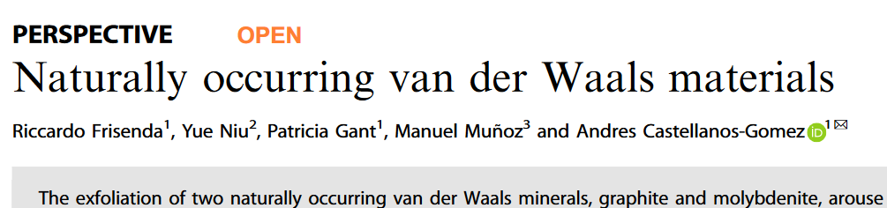
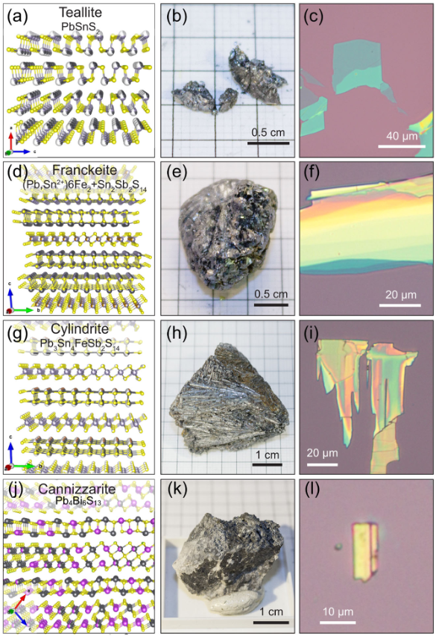
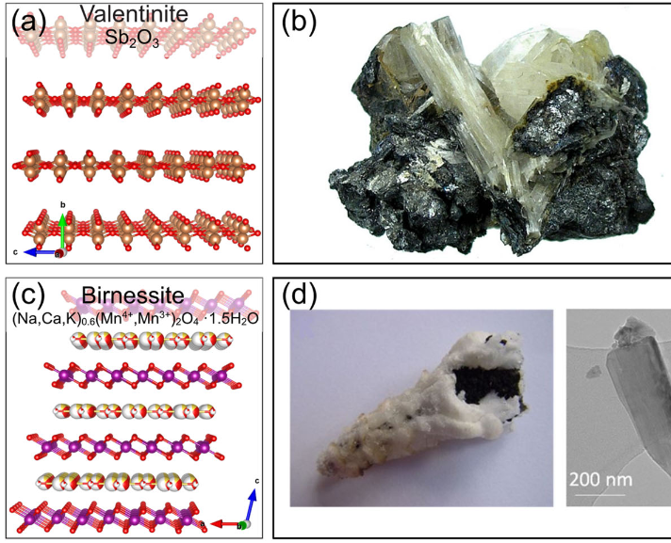
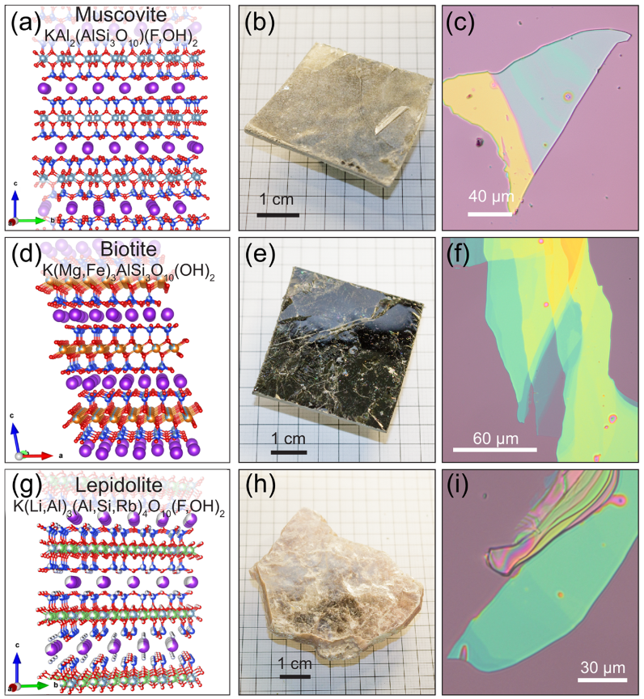
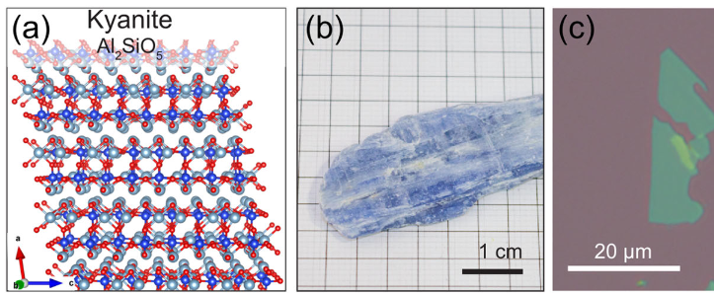

Slide 11
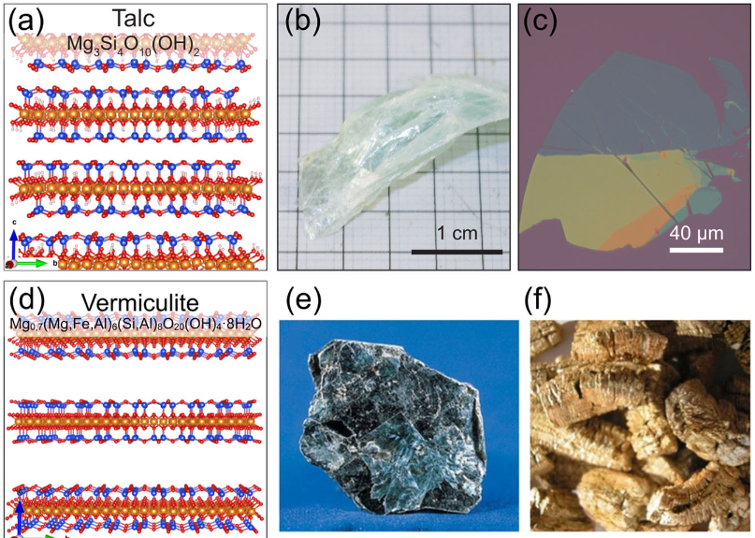

Slide 12
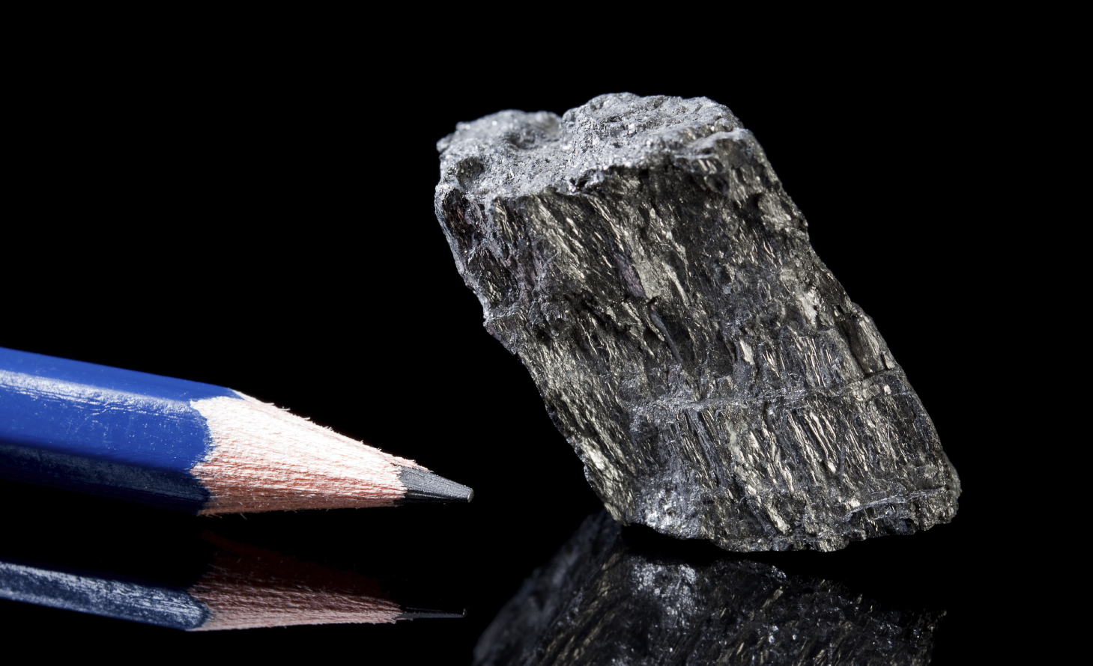
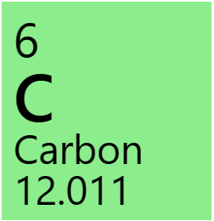
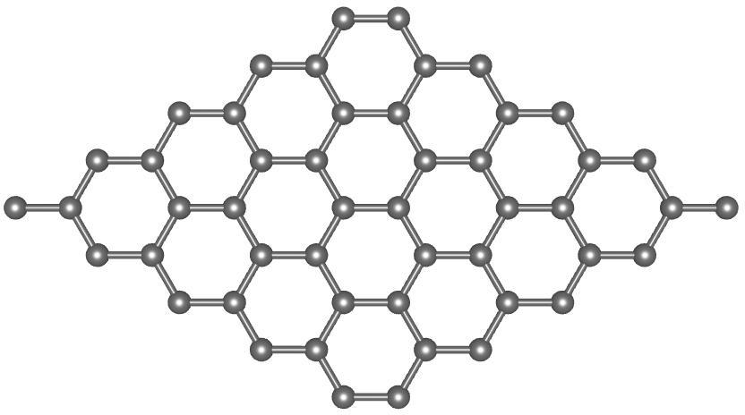
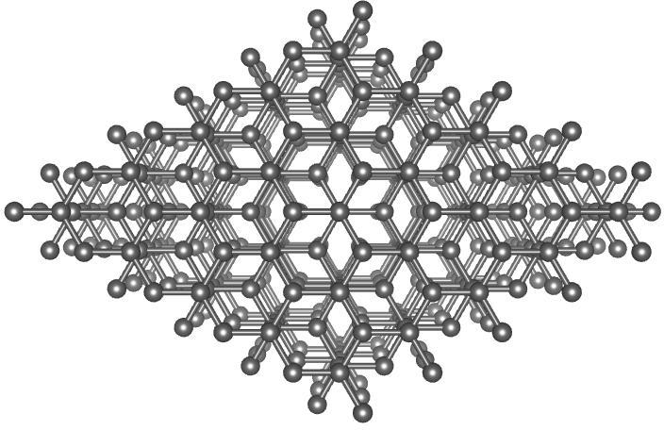

Slide 14
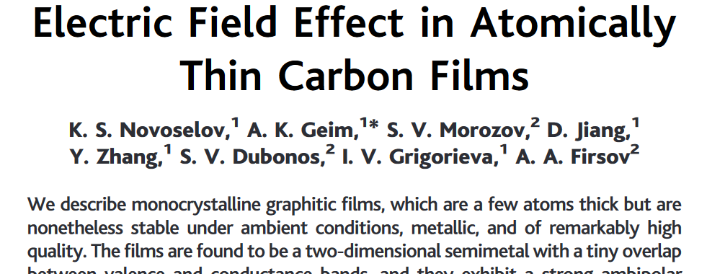
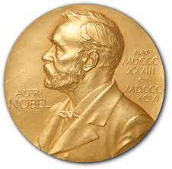
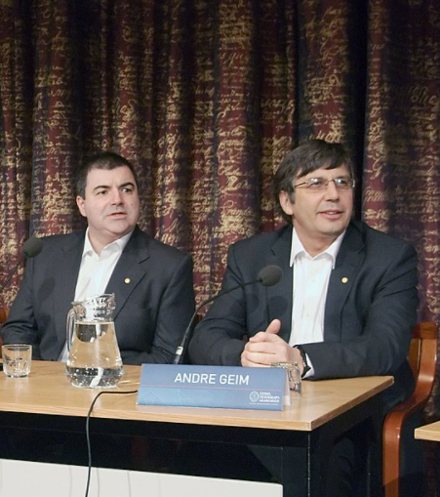
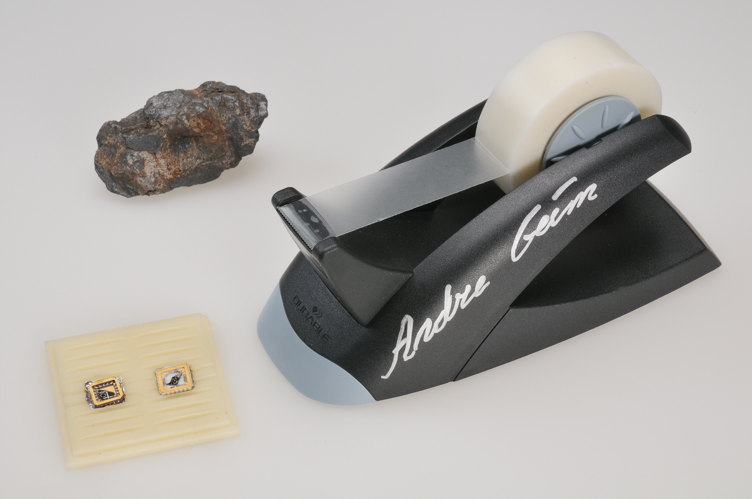
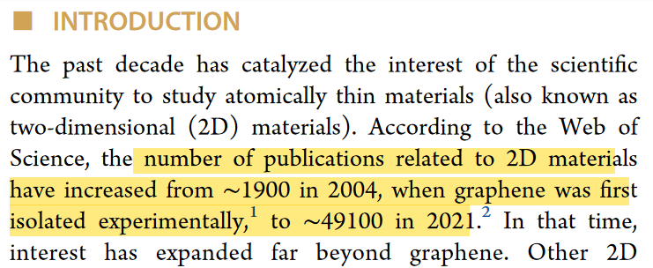
Physics
2010
Yu Lei, et al. ACS Nanosci. Au, 2, 450, 2022.

Slide 15
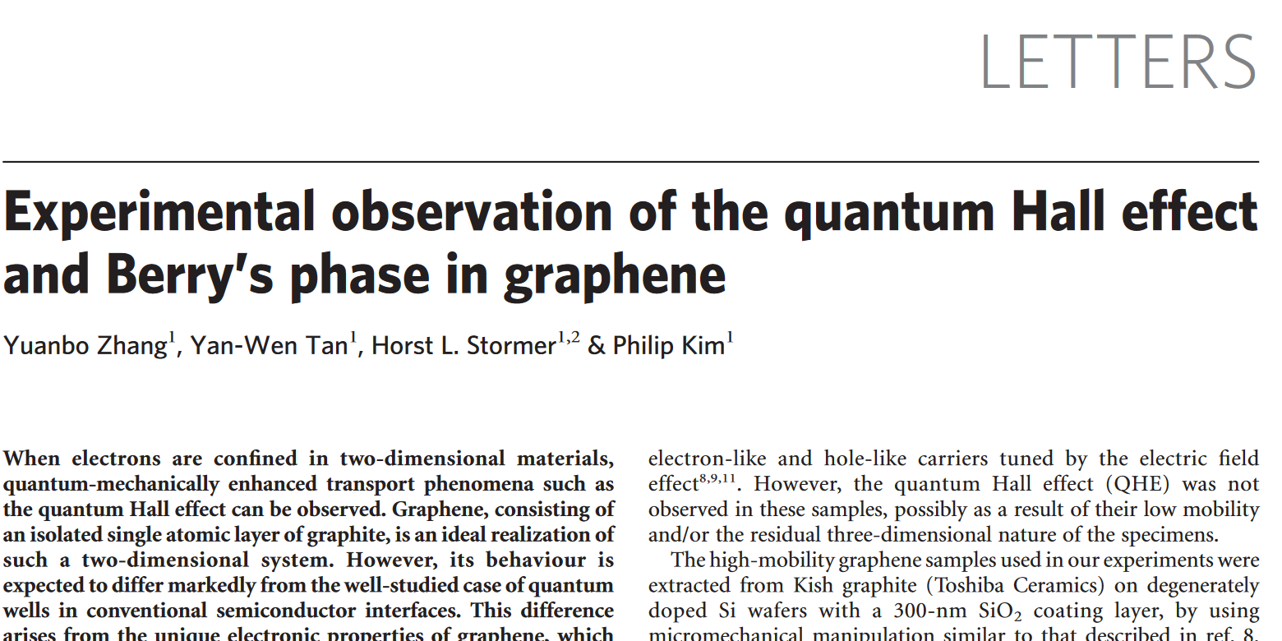
Physics
2010
Yu Lei, et al. ACS Nanosci. Au, 2, 450, 2022.

Slide 16
Thinnest. At one atom thick, it’s the thinnest material we can see.
Lightest. One square meter of graphene weighs about 0.77 milligrams. For scale, one square meter of regular paper is 1000 times heavier than graphene and a single sheet of graphene big enough to cover a football field would weigh less than a gram.
Strongest. Graphene is stronger than steel and Kevlar, with a tensile strength of 150,000,000 psi.
Stretchiest. Graphene has an amazing ability to retain its initial size after strain. Graphene sheets suspended over silicone dioxide cavities had spring constants in the region of 1-5 N/m and a Young’s modulus of 0.5 TPa.
Best Conductor of Heat. At room temperature, graphene’s heat conductivity is (4.84±0.44) × 10^3 to (5.30±0.48) × 10^3 W·m−1·K−1.
Best Conductor of Electricity. In graphene, each carbon atom is connected to three other carbon atoms on a two-dimensional plane, which leaves one electron free for electronic conduction. Recent studies have shown electron mobility at values more than 15,000 cm2·V−1·s−1. Graphene moves electrons 10 times faster than silicon using less energy.
Best Light Absorber. Graphene can absorb 2.3% of white light, which is remarkable because of its extreme thinness. This means that, once optical intensity reaches saturation fluence, saturable absorption takes place, which makes it possible to achieve full-band mode locking.
Most Renewable. Statistically speaking, carbon is the fourth most abundant element in the entire universe (by mass). Because of this abundance, graphene could well be a sustainable, ecologically friendly solution for an increasingly complex world.
Most Exceptional. What most captures the imagination is that graphene is one simple material that by itself possesses all these astonishing qualities. No other material in the world is the thinnest, strongest, lightest, and stretchiest, and can conduct heat and electricity super-fast, all at the same time.
https://www.acsmaterial.com/graphene-facts

Slide 17
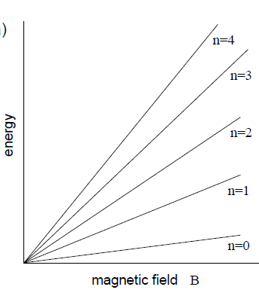
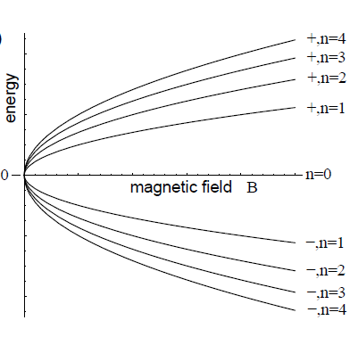
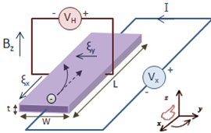
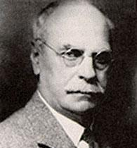
Hall Effect
Quantum Hall Effect
Anomalous Quantum Hall Effect
Edwin Herbert Hall
(1879)
Mark O. Goerbig, Quantum Hall Effects, 2009.

Slide 18
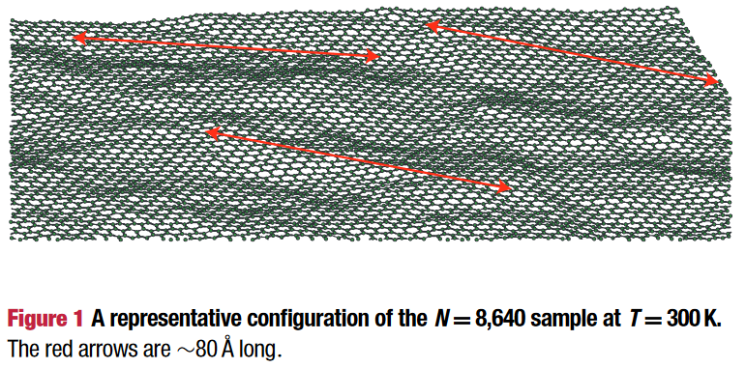
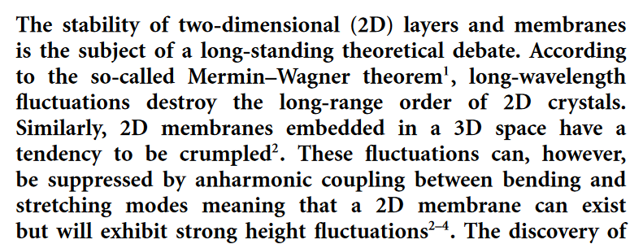

Slide 19
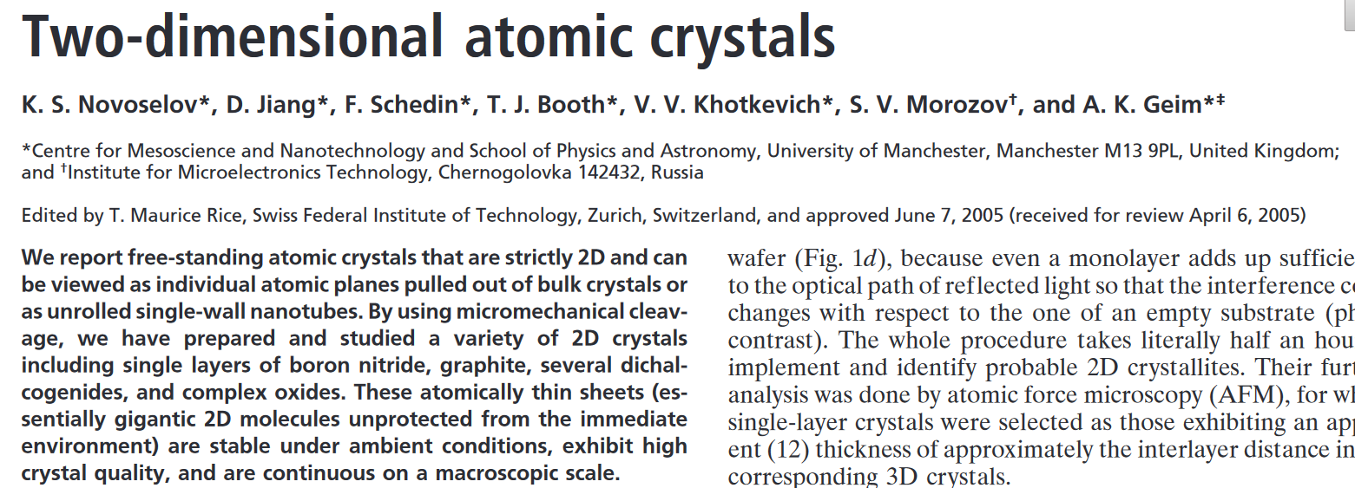
Transition Metal Dichalcogenides (TMDCs)

Slide 20
Materiais bidimensionais
atomicamente finos
Cristais com um ou poucos átomos de espessura
O que são?
Interações eletrônicas no plano são muito mais fortes do que aquelas na direção perpendicular ao plano.
Para que servem?

Slide 21
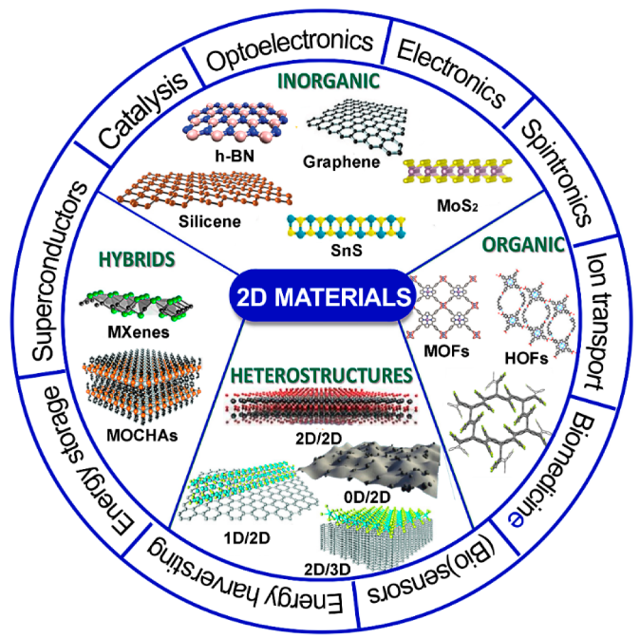
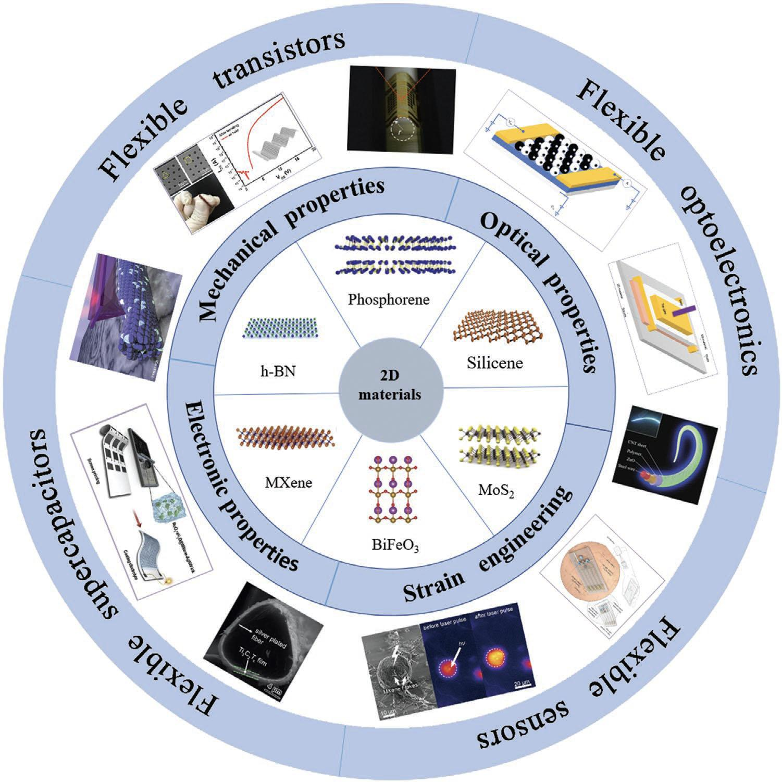
D. Scarano, Materials, 14(23), 7108, 2021.
https://www.nanowerk.com/spotlight/spotid=60554.php

Slide 22
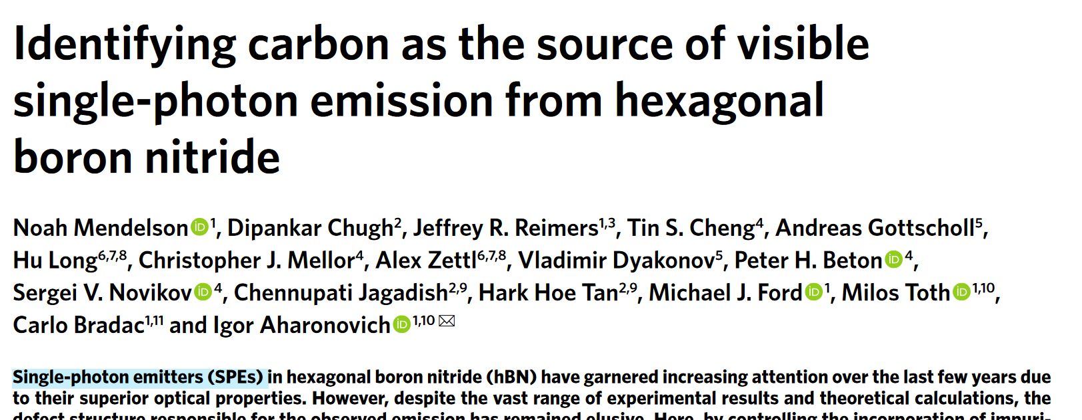
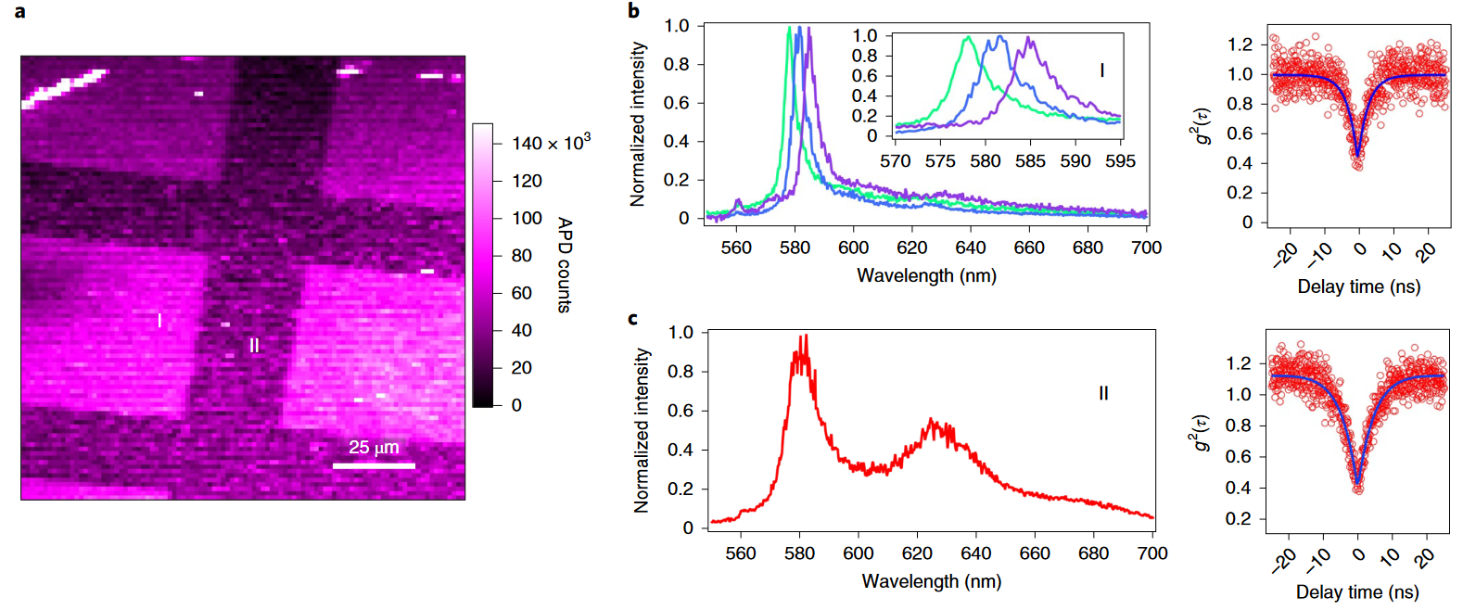
Quantum Information

Slide 23
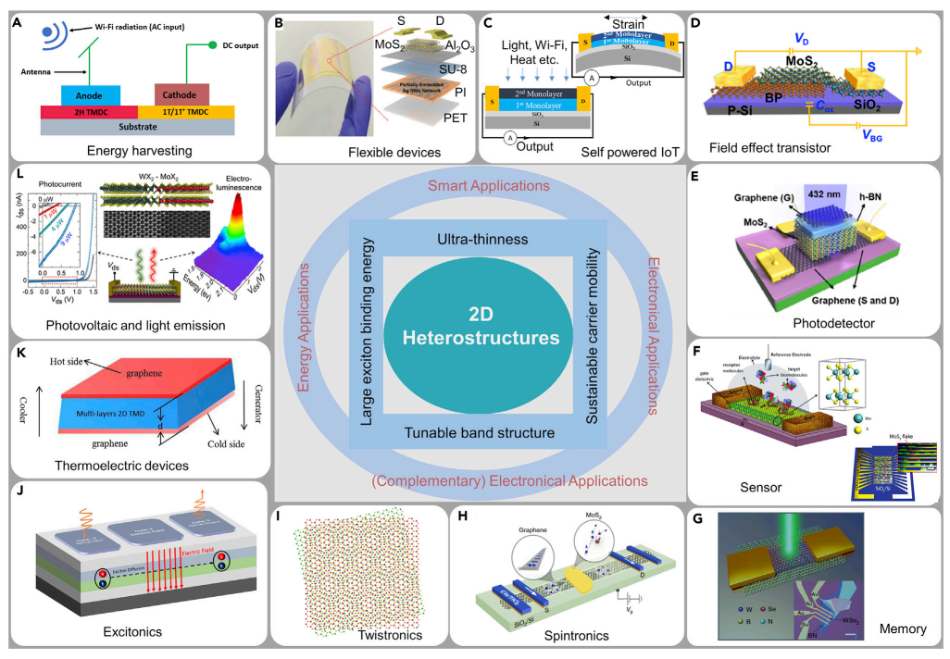
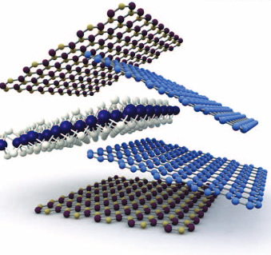
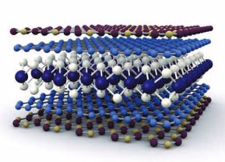
K. S. Novoselov, Science, 353, 2016
S. K. Chakraborty, iScience 25, 103942, 2022

Slide 24
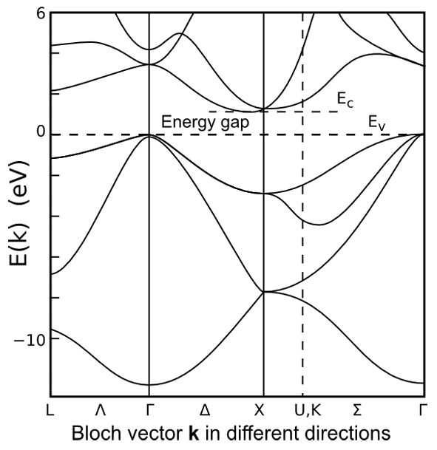
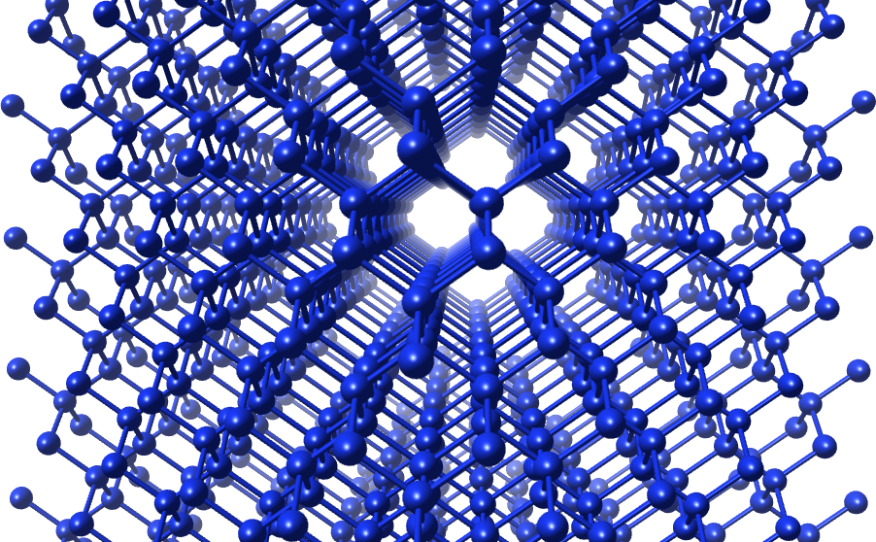
Electronic Band Structure

Slide 25
Bonding States: H₂ molecule
1s¹
E = -13.6 eV
1s¹
H
H

Slide 26
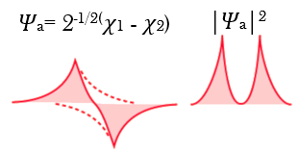
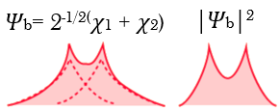
Bonding States: H₂ molecule
σ*
1s¹
E = -13.6 eV
1s¹
σ
H
H

Slide 27
Bonding States: H₂ molecule
σ*
1s¹
E = -13.6 eV
1s¹
σ
H
H

Slide 28
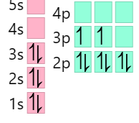
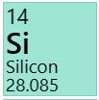
Electronic Band Structure: Si crystal
Valência: 3s² 3p²
3p
3p
3s
3s
Si
Si

Slide 29
Electronic Band Structure: Si crystal
Valência: 3s² 3p²
3p
3p
3s
3s
Si
Si

Slide 30
Electronic Band Structure: Si crystal
Valência: 3s² 3p²
3p
3p
3s
3s
Si
Si

Slide 31
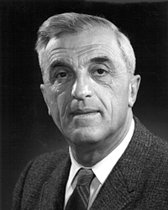
Electronic Band Structure: Si crystal
If we have a lot of atoms? (~ 10²³)
(Empty states)
Conduction
Valence
(Occupied states)
Felix Bloch
(1905-1983)
Bloch’s Theorem
Andreas Wacker Notes (2018)

Slide 32
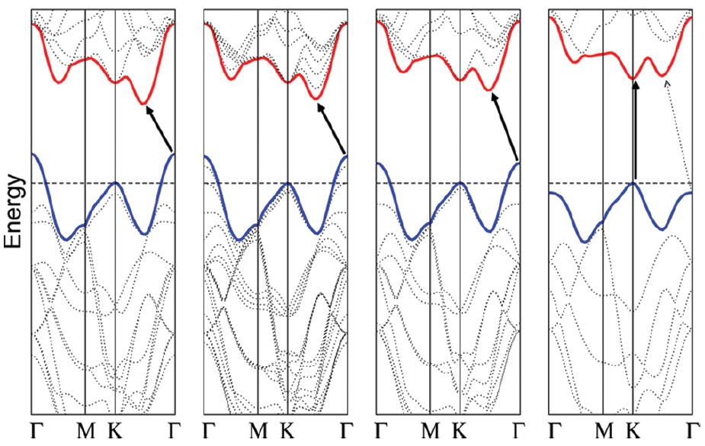
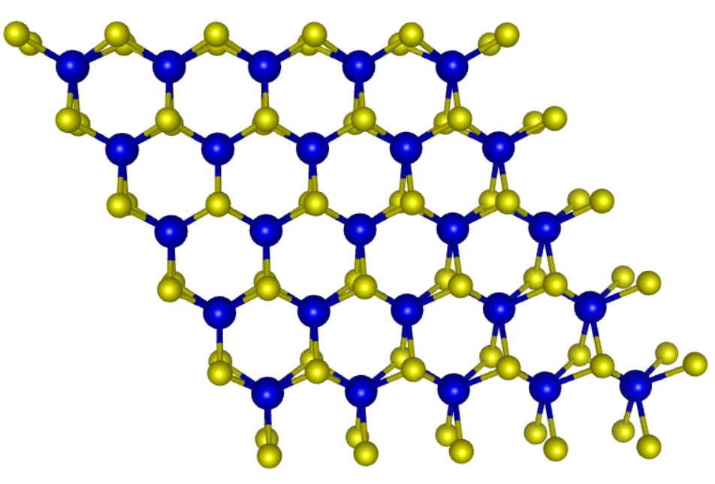
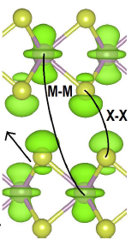
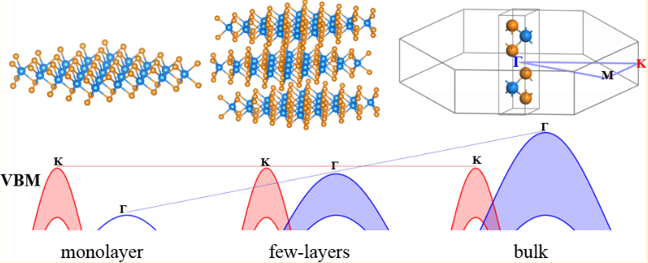
Band Gap Tuning: TMDCs
MoS₂
Mo-d
TX₂
Mo-d + S-p_{z}
Bulk
4L
2L
1L
A..Splendiani, et. al, Nano Lett., 10, 2010

Slide 33
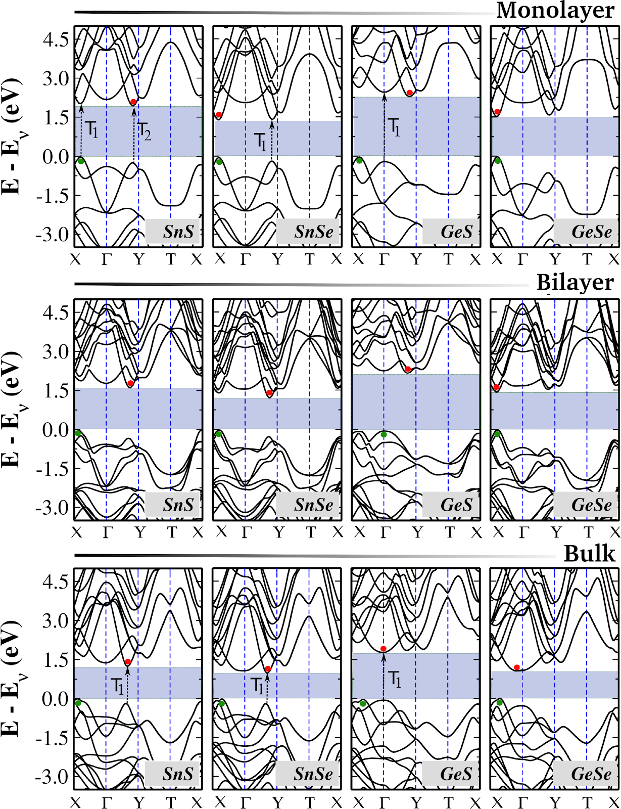
Band Gap Tuning: Group-IV Monochalcogenides
MX
2.3 eV
M = Sn, Ge, X = S, Se
k_{x}
2D GeS 3D SnSe
Gaps de energia cobrindo toda a região do visível.
Lídia Gomes and A. Carvalho, PRB, 92, 2015
1 eV

Slide 34
A. Chaves, et al. npj 2D Mat. and Appl., 2020.

Slide 35
Band Gap Tuning: TMDCs
Spin Orbit Coupling (SOC)
WS₂
Relativistic interaction of a particle's spin with its motion inside a potential.
Y. Sun. et. al, J. Phys. Chem. C., 120, 2016

Slide 36
Band Gap Tuning: TMDCs
WS₂
Y. Sun. et. al, J. Phys. Chem. C., 120, 2016

Slide 37
Band Gap Tuning: TMDCs
WS₂
Y. Sun. et. al, J. Phys. Chem. C., 120, 2016

Slide 38
Spintronics
spin transport electronics
Electronics

Slide 39
Song et al., Science 360, 1214, 2018.

Slide 40
Symmetry loss in 2D systems
Piezoelectricity
α-Quartz
SiO₄

Slide 41
Symmetry loss in 2D systems
Piezoelectricity

Slide 42
Symmetry loss in 2D systems
Piezoelectricity

Slide 43
Muitas (todas?) propriedades interessantes dos materiais 2D surgem devido às fortes correlações eletrônicas.
Modos coletivos!

Slide 44
New properties due to high electronic correlation
Poor screening in 2D systems
V ∝ q²/r
V ∝ q²/𝜺r
https://tikz.net/electric_fieldlines2/

Slide 45
Modified Coulomb potential in 2D systems

Slide 46
Excitons
-
+
J. Hwang et al.,Sci. Report, 10, 2020

Slide 47
Excitons
-
+
J. Hwang et al.,Sci. Report, 10, 2020

Slide 49
Excitons
Alex. Rodin, Nature Rev., 2, 2020.

Slide 50
Excitons: Group IV-Monochalcogenides
on top of a substrate
free standing layer

Slide 51
Topological excitations: Skyrmions, Merons
Alex. Rodin, Nature Rev., 2, 2020.

